Slide 1
Applied Statistics for AI (CMAI 6203 )
Week-5 :EDA
Measures of Dispersion

Slide 2
Preambles:
Basic terminologies of Statistics used in AI
Measures of Central tendency

Slide 3
Dispersion:
dispersion is primarily a statistical concept used to measure the "spread" or variability of data within a dataset. It is a critical counterpart to measures of central tendency (like the mean), providing essential context for model training, evaluation, and reliability.

Slide 4
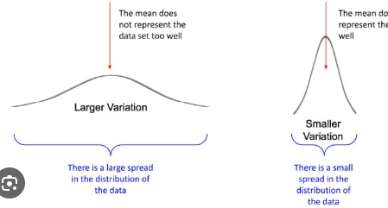
Dispersion quantifies how much data points deviate from a central value. In AI and Machine Learning (ML), this helps developers understand the diversity and consistency of their training data

Slide 5
Why Data Dispersion Matters in AI
Revealing Data Spread
Identifying Variability
Enhancing Decision-Making
Dispersion reveals how data points spread around averages, which is crucial for building accurate AI models. It helps us see beyond just the mean.
High variability can signal noise, highlight outliers, or indicate diverse underlying patterns that significantly impact predictive accuracy.
Understanding dispersion helps improve data quality, increases model robustness, and leads to more informed, reliable decision-making in AI applications.

Slide 6
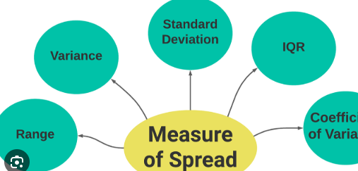
Core Measures of Data Dispersion are:

Slide 7
Core Measures of Data Dispersion are:
Range=max value-Min value

Slide 8
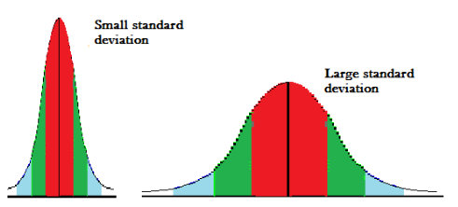
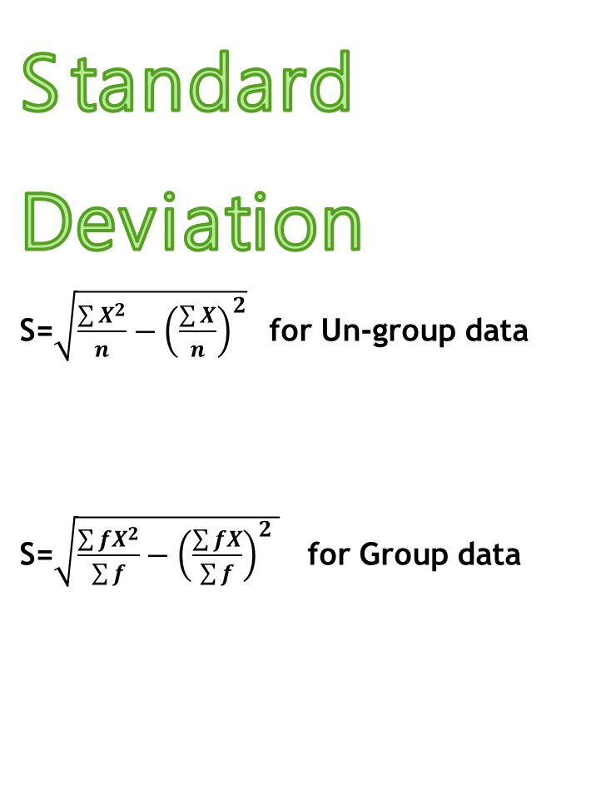
Core Measures of Data Dispersion are:
Standard Deviation
S=$\sqrt{\frac{\sum{X^{2}}}{n}−{\left(\frac{\sum{X}}{n}\right)}^{2}}$ for Un-group data
S=$\sqrt{\frac{\sum{fX^{2}}}{\sum{f}}−{\left(\frac{\sum{fX}}{\sum{f}}\right)}^{2} }$ for Group data

Slide 9
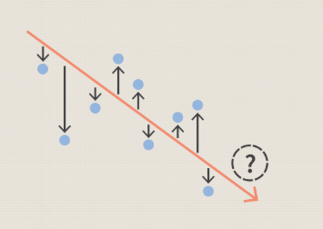
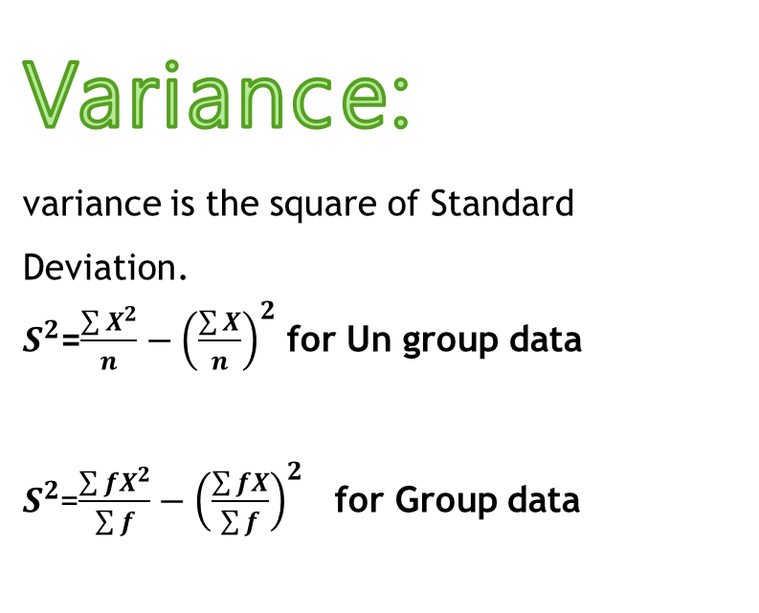
Variance:
variance is the square of Standard Deviation.
$S^{2}$=$\frac{\sum{X^{2}}}{n}−{\left(\frac{\sum{X}}{n}\right)}^{2}$ for Un group data
$S^{2}$=$\frac{\sum{fX^{2}}}{\sum{f}}−{\left(\frac{\sum{fX}}{\sum{f}}\right)}^{2}$ for Group data

Slide 10
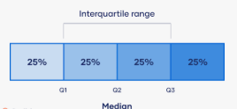
Inter Quartile Range
The interquartile range (IQR) is a statistical measure that represents the spread of the middle 50% of a dataset. It is calculated by subtracting the first quartile (Q1) from the third quartile (Q3).
IQR=Q3-Q1
Common use of IQR are:
Outlier detection
Comparison of datasets

Slide 11
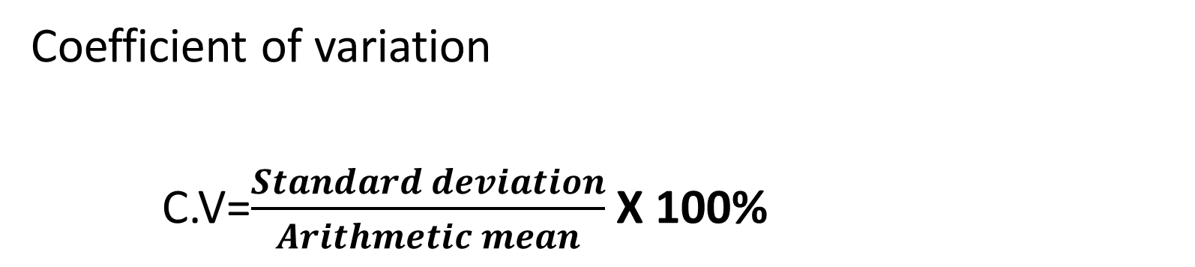
Measure of Consistency of data:
Coefficient of variation
C.V=$\frac{Standard deviation}{Arithmetic mean}$ X 100%

Slide 12
Dispersion Challenges in AI Datasets
Diverse & Noisy Data
Outliers & Skewed Distributions
Real-world Variability
Large-scale AI models often ingest diverse and noisy data, each with its own unique dispersion characteristics, making consistent analysis difficult.
Consider energy consumption prediction: variability by neighborhood demands tailored models. A one-size-fits-all approach often fails when dispersion isn't accounted for.
Unmanaged outliers and skewed distributions can mislead model training, resulting in degraded performance and inaccurate predictions. This can be particularly problematic in sensitive applications.

Slide 13
Dispersion-Informed Data Preprocessing Techniques
01
02
03
Outlier Detection & Removal
Normalization & Scaling
Stratified Sampling
Employ techniques like Interquartile Range (IQR) or Median Absolute Deviation (MAD) to identify and handle extreme values that can skew analysis and model training.
Apply normalization and scaling methods to reduce the impact of variance on model convergence, ensuring features contribute equally during training.
Use stratified sampling to ensure that training and testing splits maintain the representative dispersion of the original dataset, preventing sampling bias.

Slide 14
Conclusion: Mastering Data Dispersion for AI Excellence
Foundational Concept: Dispersion is a foundational concept that unlocks deeper data understanding, moving beyond simple averages.
Enhanced AI Models: Applying dispersion techniques significantly enhances AI model quality, promoting fairness, and building trustworthiness.
Essential Workflow Step: Embrace dispersion analysis as a key, indispensable step in your AI data science workflow to ensure robust and reliable outcomes.

Slide 15
Problem 1 (Sensor Data Consistency)
Two sensors measure temperature (°C):
Sensor A: 20, 21, 19, 22, 18, 20
Sensor B: 20, 20, 21, 19, 20, 20
Tasks
1. Calculate mean temperature.
2.Calculate variance and standard deviation.
3.Compute coefficient of variation.
4.Identify which sensor is more reliable/consistent

Slide 16
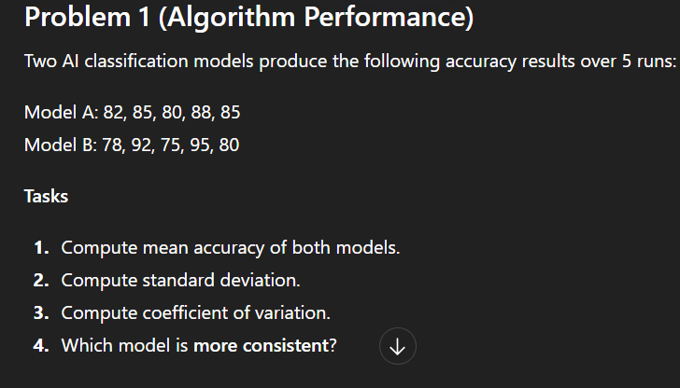

Slide 17
Problem2: Model Accuracy
Q3:The following table shows training accuracy (%) of an AI model across different experiment runs.
Tasks
Find the mean accuracy.
Calculate the standard deviation for the grouped data.
Compute the coefficient of variation.
Accuracy (%) | Frequency
60–65 | 4
65–70 | 6
70–75 | 10
75–80 | 8
80–85 | 2

Slide 18
Problem4: Outlier Detection using the IQR method
The following data represent the number of hours students studied in a week:
3, 5, 7, 8, 9, 10, 12, 13, 15, 18, 22
Calculate Q₁ (first quartile) and Q₃ (third quartile).
Find the Interquartile Range (IQR).
Determine the lower fence and upper fence using the IQR method.
Identify any outliers in the dataset.

Slide 19
Problem 5: Outlier detection
The following data represent daily sales (in units) of a shop over several days:
4, 6, 7, 8, 9, 10, 11, 12, 13, 15, 18, 20, 35, 42
Tasks
1.Find Q₁ (first quartile) and Q₃ (third quartile).
2. Calculate the Interquartile Range (IQR).
3. Determine the lower fence and upper fence using the IQR rule.
4. Identify all outliers in the dataset.

